Slide 1
Applied Software Security
Tutorial and Practice
Week 1

Slide 2
What?
Digital devices are complicated
Software is complicated
More complexity → More bugs
Unexpected behavior + malicious actors = trouble
Complicated enough to warrant an entire discipline
Knowledge is power

Slide 3
How?
Disciplines and knowledge:
  Coding, assembly, programming languages
  Computers and operating systems
  Networking and hardware interfaces
  Debugging (as a discipline)
  Code auditing
  Cryptography
  And more...

Slide 4
How?
Reverse engineering* / “white-box” analysis
  High-level code, decompiled and disassembled code
Binary analysis
  Files, formats, protocols, filesystems, DBs, data structures
Dynamic analysis
  Debugging†, “black-box” analysis, testing and automation
Network and system analysis
  Packets, logs, messages, etc.
* Technically everything here falls under “reverse engineering”, but in our world the term is used mostly for white-box analysis, sometimes even in a stricter sense of binary code analysis
† Here referring to monitored execution of a program using a debugger, and not the general idea of finding bugs

Slide 5
Why?
Defense
  Know your enemy
  Analyze malicious code
  Assess vulnerabilities
  Get there before the bad guys
Offense
  Can be done for good deeds
  Law enforcement, etc.
Malicious reasons
  Don’t even think about it
  Malware/cracking/illegal espionage

Slide 6
Responsibility
With great power comes great responsibility

Slide 7
Assembly Recap
We will be working with 32-bit and 64-bit x86 assembly (most commonly encountered today)

Slide 8
What does the following code do? (32-bit)
  input is in eax and output is in eax
mov edx, eax
mov bl, [eax]
test bl, bl
jz loop_end
loop_start:
inc eax
mov bl, [eax]
test bl, bl
jnz loop_start
loop_end:
sub eax, edx

Slide 9
What does the following code do? (32-bit)
  input is in eax and output is in eax
mov edx, eax
mov bl, [eax]
test bl, bl
jz loop_end
loop_start:
inc eax
mov bl, [eax]
test bl, bl
jnz loop_start
loop_end:
sub eax, edx
; original input is now in edx
; load byte at eax to bl
; check if bl is zero
; if true, go to end
; eax++
; load byte at eax to bl
; check if bl is zero
; repeat until bl=0
; return diff between eax and original input
Answer: finds the index of first zero byte (strlen)

Slide 10
What does the following code do? (32-bit)
  input is in eax and output is in eax
mov edi, eax
xor eax, eax
xor ecx, ecx
not ecx
cld
repne scasb
inc ecx
not ecx
mov eax, ecx

Slide 11
What does the following code do? (32-bit)
  input is in eax and output is in eax
mov edi, eax
xor eax, eax
xor ecx, ecx
not ecx
cld
repne scasb
inc ecx
not ecx
mov eax, ecx
; initialize edi with input
; zero eax
; zero ecx
; ecx = 0xFFFFFFFF
; ???
; ???
; what?
; why?
; move result from ecx to eax
What do cld and repne scasb do?
  We know they do something with edi, eax and ecx
  Time to check the manual...

Slide 12

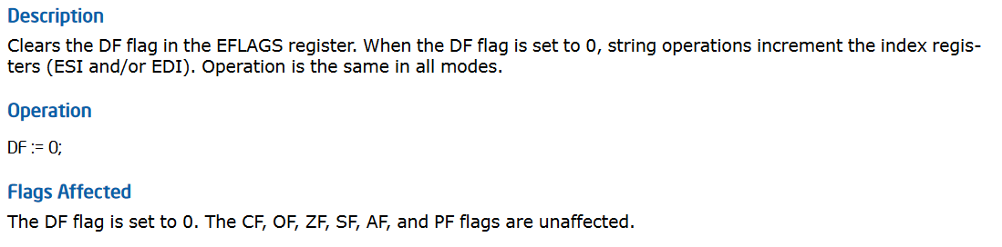
CLD
  From Intel’s official instruction set manual

Slide 13
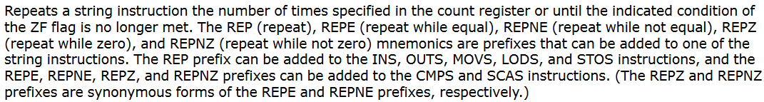
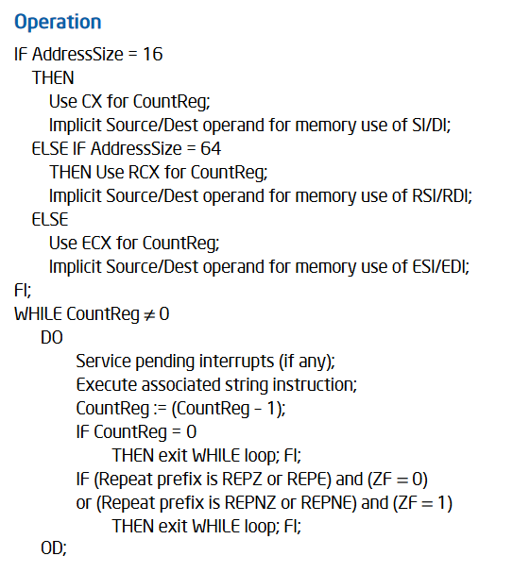
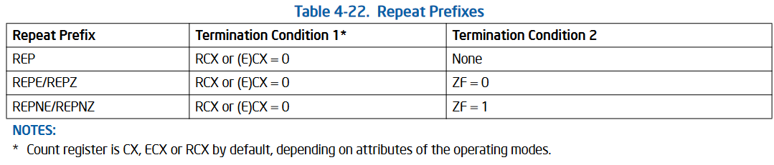
REPNE
  From Intel’s official instruction set manual

Slide 14
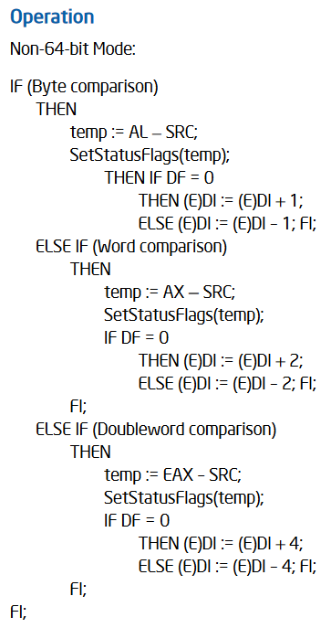
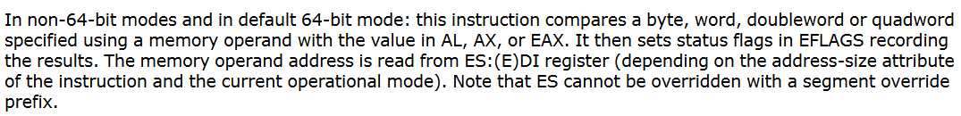
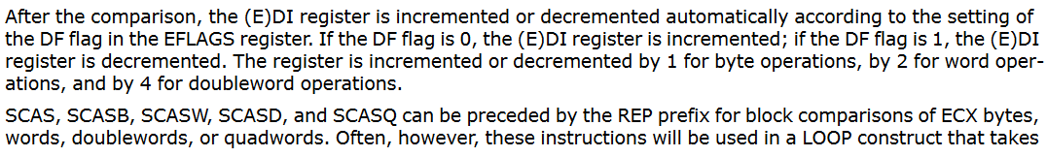
SCASB
  From Intel’s official instruction set manual

Slide 15
tl;dr:
cld – Clear Direction Flag (DF)
  Part of the FLAGS register
repne – Repeat String Operation Prefix
  Repeats a string instruction (scasb in our code) the number of times specified in ecx
  Decrements ecx with each iteration
  Stops when ecx=0 or until ZF=1
scasb – Scan String (Byte)
  Compares a byte pointed to by edi to the value of al and sets flags accordingly (OF, SF, ZF, AF, PF, CF)
  Increments edi by one if DF=0, decrements by one if DF=1
Analogous instructions exist for 64-bit addressing (using rdi, rcx), and to compare words (ax), dwords (eax) and qwords (rax) (the latter in 64-bit mode only)

Slide 16
What does the following code do? (32-bit)
  input is in eax and output is in eax
mov edi, eax
xor eax, eax
xor ecx, ecx
not ecx
cld
repne scasb
inc ecx
not ecx
mov eax, ecx
; initialize edi with input
; zero eax
; zero ecx
; ecx = 0xFFFFFFFF
; DF=0
; repeat compare to al=0
; ecx++
; not ecx
; move result from ecx to eax
What happens to ecx?
Before repne scasb we have ecx = 0xFFFFFFFF = (-1)
After repne scasb, we have ecx = -1 - index - 1
  The extra (-1) is because ecx is decremented once more when the zero byte is found
After inc ecx we have ecx = -(index + 1)
Remember 2’s complement means applying not then incrementing by one to get a sign change
  If we not ecx but don’t increment by one, we get the number immediately preceding (index + 1)
So after not ecx we have ecx = index

Slide 17
Assembly
So, what does the code do?
Answer: finds the index of the first zero byte in a string. In other words: strlen, again!
It is often useful to check simple cases, for example, a string of length 1 (2 bytes including the null terminator)
Registers/Flags
Memory
eip
mov edi, eax
xor eax, eax
xor ecx, ecx
not ecx
cld
repne scasb
inc ecx
not ecx
mov eax, ecx
...
eax
10000: 4A
10001: 00
10002: 00
10003: 00
... : ...
eax = 0x00010000
edi = 0x????????
ecx = 0x????????
DF: ? ZF: ?

Slide 18
Assembly
So, what does the code do?
Answer: finds the index of the first zero byte in a string. In other words: strlen, again!
It is often useful to check simple cases, for example, a string of length 1 (2 bytes including the null terminator)
Registers/Flags
Memory
mov edi, eax
xor eax, eax
xor ecx, ecx
not ecx
cld
repne scasb
inc ecx
not ecx
mov eax, ecx
...
eip
eax, edi
10000: 4A
10001: 00
10002: 00
10003: 00
... : ...
eax = 0x00010000
edi = 0x00010000
ecx = 0x????????
DF: ? ZF: ?

Slide 19
Assembly
So, what does the code do?
Answer: finds the index of the first zero byte in a string. In other words: strlen, again!
It is often useful to check simple cases, for example, a string of length 1 (2 bytes including the null terminator)
Registers/Flags
Memory
mov edi, eax
xor eax, eax
xor ecx, ecx
not ecx
cld
repne scasb
inc ecx
not ecx
mov eax, ecx
...
edi
10000: 4A
10001: 00
10002: 00
10003: 00
... : ...
eip
eax = 0x00000000
edi = 0x00010000
ecx = 0x????????
DF: ? ZF: 1

Slide 20
Assembly
So, what does the code do?
Answer: finds the index of the first zero byte in a string. In other words: strlen, again!
It is often useful to check simple cases, for example, a string of length 1 (2 bytes including the null terminator)
Registers/Flags
Memory
mov edi, eax
xor eax, eax
xor ecx, ecx
not ecx
cld
repne scasb
inc ecx
not ecx
mov eax, ecx
...
edi
10000: 4A
10001: 00
10002: 00
10003: 00
... : ...
eax = 0x00000000
edi = 0x00010000
ecx = 0x00000000
DF: ? ZF: 1
eip

Slide 21
Assembly
So, what does the code do?
Answer: finds the index of the first zero byte in a string. In other words: strlen, again!
It is often useful to check simple cases, for example, a string of length 1 (2 bytes including the null terminator)
Registers/Flags
Memory
mov edi, eax
xor eax, eax
xor ecx, ecx
not ecx
cld
repne scasb
inc ecx
not ecx
mov eax, ecx
...
edi
10000: 4A
10001: 00
10002: 00
10003: 00
... : ...
eax = 0x00000000
edi = 0x00010000
ecx = 0xffffffff
DF: ? ZF: 1
eip

Slide 22
Assembly
So, what does the code do?
Answer: finds the index of the first zero byte in a string. In other words: strlen, again!
It is often useful to check simple cases, for example, a string of length 1 (2 bytes including the null terminator)
Registers/Flags
Memory
mov edi, eax
xor eax, eax
xor ecx, ecx
not ecx
cld
repne scasb
inc ecx
not ecx
mov eax, ecx
...
al
10000: 4A
10001: 00
10002: 00
10003: 00
... : ...
edi
eax = 0x00000000
edi = 0x00010000
ecx = 0xffffffff
DF: 0 ZF: 1
eip

Slide 23
Assembly
So, what does the code do?
Answer: finds the index of the first zero byte in a string. In other words: strlen, again!
It is often useful to check simple cases, for example, a string of length 1 (2 bytes including the null terminator)
Registers/Flags
Memory
mov edi, eax
xor eax, eax
xor ecx, ecx
not ecx
cld
repne scasb
inc ecx
not ecx
mov eax, ecx
...
al
10000: 4A
10001: 00
10002: 00
10003: 00
... : ...
eax = 0x00000000
edi = 0x00010001
ecx = 0xfffffffe
DF: 0 ZF: 0
edi
eip

Slide 24
Assembly
So, what does the code do?
Answer: finds the index of the first zero byte in a string. In other words: strlen, again!
It is often useful to check simple cases, for example, a string of length 1 (2 bytes including the null terminator)
Registers/Flags
Memory
mov edi, eax
xor eax, eax
xor ecx, ecx
not ecx
cld
repne scasb
inc ecx
not ecx
mov eax, ecx
...
al
10000: 4A
10001: 00
10002: 00
10003: 00
... : ...
eax = 0x00000000
edi = 0x00010002
ecx = 0xfffffffd
DF: 0 ZF: 0
edi
eip

Slide 25
Assembly
So, what does the code do?
Answer: finds the index of the first zero byte in a string. In other words: strlen, again!
It is often useful to check simple cases, for example, a string of length 1 (2 bytes including the null terminator)
Registers/Flags
Memory
mov edi, eax
xor eax, eax
xor ecx, ecx
not ecx
cld
repne scasb
inc ecx
not ecx
mov eax, ecx
...
10000: 4A
10001: 00
10002: 00
10003: 00
... : ...
eax = 0x00000000
edi = 0x00010002
ecx = 0xfffffffe
DF: 0 ZF: 0
edi
eip

Slide 26
Assembly
So, what does the code do?
Answer: finds the index of the first zero byte in a string. In other words: strlen, again!
It is often useful to check simple cases, for example, a string of length 1 (2 bytes including the null terminator)
Registers/Flags
Memory
mov edi, eax
xor eax, eax
xor ecx, ecx
not ecx
cld
repne scasb
inc ecx
not ecx
mov eax, ecx
...
10000: 4A
10001: 00
10002: 00
10003: 00
... : ...
eax = 0x00000000
edi = 0x00010002
ecx = 0x00000001
DF: 0 ZF: 1
edi
eip

Slide 27
Assembly
So, what does the code do?
Answer: finds the index of the first zero byte in a string. In other words: strlen, again!
It is often useful to check simple cases, for example, a string of length 1 (2 bytes including the null terminator)
Registers/Flags
Memory
mov edi, eax
xor eax, eax
xor ecx, ecx
not ecx
cld
repne scasb
inc ecx
not ecx
mov eax, ecx
...
10000: 4A
10001: 00
10002: 00
10003: 00
... : ...
eax = 0x00000001
edi = 0x00010002
ecx = 0x00000001
DF: 0 ZF: 1
edi
eip

Slide 28
Assembly
So, what does the code do?
Answer: finds the index of the first zero byte in a string. In other words: strlen, again!
It is often useful to check simple cases, for example, a string of length 1 (2 bytes including the null terminator)
mov edi, eax
xor eax, eax
xor ecx, ecx
not ecx
cld
repne scasb
inc ecx
not ecx
mov eax, ecx
;
;
; ecx = 0
; ecx = 0xFFFFFFFF = -1
;
; ecx-- ; (repeat once, hece ecx = -2)
; ecx = -1 = 0xFFFFFFFF
; ecx = 0
; result = 0
Question: why did we have to start with ecx = 0xFFFFFFFF? What happens if we start with ecx=0?

Slide 29
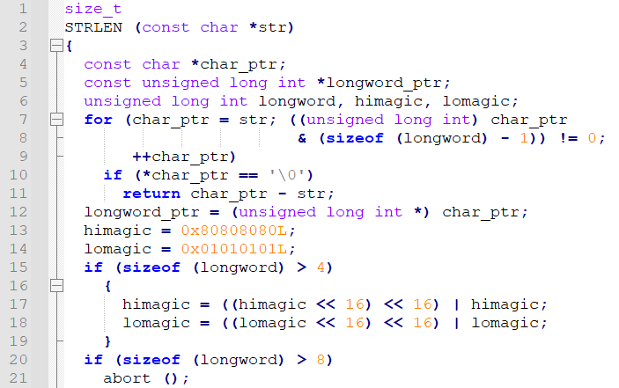
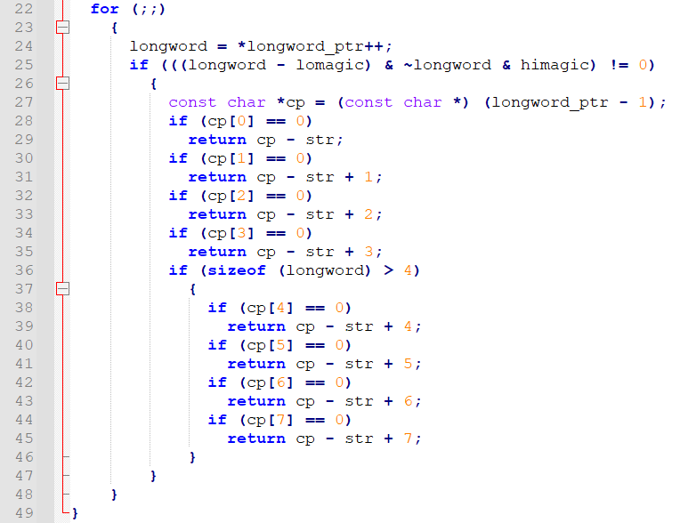
Disclaimer
Actual implementations of strlen are different. Take the GNU libc implementation for example: (C code; comments omitted)
This will compile to significantly more instructions, but will be much more run-time efficient (looks at 4/8 bytes at a time, instead of just one)

Slide 30
Disclaimer
Usually an architecture-specific implementation overrides the generic c code for strlen and other useful functions.
  On modern x86 PCs for example, GNU libc will use instructions and registers that are part of the SSE2 (Streaming SIMD Extensions 2) supplementary instruction set, or later extensions.
In general, simple tasks often become much more complicated, from both the programmer’s and reverse engineer’s perspective
  To make things worse for RE, some decompilers don’t handle architecture-specific implementations well
  Sometimes it’s quicker to use other methods rather than following the code instruction by instruction

Slide 31
Assembly
What does the following code do?
  Input is in eax and output is in eax
  Warning: there may be a bug here
mov ecx, eax
xor ebx, ebx
mov eax, 1
_loop_start:
add eax, ebx
sub ebx, eax
neg ebx
loop _loop_start
;eax = eax + ebx
;ebx = ebx – eax
;ebx = -ebx
| a’ = a + b
| b’ = b – a’ = -a
| b’’ = -b’ = a

Slide 32
Assembly
Answer: computes the n-th Fibonacci number
  n is the input (ecx) and the result is in eax
Input (ecx) | 1 | 2 | 3 | 4 | 5 | 6 | 7 | 8 | 9
Output (eax) | 1 | 2 | 3 | 5 | 8 | 13 | 21 | 34 | 55
*note: the first two Fibonacci numbers are sometimes taken to be [0, 1] or [1, 1]
Questions:
  What happens when the input (ecx) is 0?
  Why in such a roundabout way (sub, neg)?
You may encounter weird ways of computing stuff
Usually, though, the computation will be straightforward

Slide 33
Assembly
A more straightforward approach for the same code will be:
mov ecx, eax
xor ebx, ebx
mov eax, 1
_loop_start:
mov edx, eax
add eax, ebx
mov ebx, edx
loop _loop_start
What would you do to compute the following values for the given inputs instead?
Input | 0 | 1 | 2 | 3 | 4 | 5 | 6 | 7 | 8 | 9 | 10 | 11 | 12
Output | 0 | 1 | 1 | 2 | 3 | 5 | 8 | 13 | 21 | 34 | 55 | 89 | 144
Try it yourself! (you will probably need more instructions)

Slide 34
Assembler Practical Info
In this course we will be using nasm
  https://www.nasm.us/
Example files will be provided for assembly with a C function wrapper and for assembly to naked binaries

Slide 35
Functions and the stack
The basic concept of a function or subroutine has to translate to machine code somehow
In C a function can accept a fixed number of parameters (0 or more), or even a variable number of parameters
It may also return some value (but only one)
After a function is done, execution returns seamlessly to the code that called the function
Functions can be nested and even recursive
An elegant solution to accomplish all of this is the program stack

Slide 36
The stack, in general terms (reminder):
  An area of memory with a “top” pointer
  Each function uses its own “stack frame”
  Saves local variables, some function parameters, and the code return address when calling a function.
  Fulfills all the requirements of the functional programming abstraction

Slide 37
Calling conventions
Let’s start with 32-bit x86:
Historically fewer general-purpose registers than x86_64
Modern x86 needs to be backwards-compatible to code written for early processors
Therefore, by default (using stdcall), all the params are passed on the stack, and all registers except eax are saved by the callee
eax holds the return value
The return address is the last thing pushed onto the stack, when the call instruction is run (this is part of the instruction)
Other conventions exits (e.g. fastcall, which uses general purpose registers for params)
We glossed over some details here, e.g. how structures are passed and returned, what happens with floating-point numbers, OOP (C++) member functions (methods), etc.

Slide 38
In x86-64 there is no shortage of general purpose registers, so all popular conventions use the registers for the first arguments
There still is a difference in which and how many registers are used
Practical info can be found on Wikipedia:
  https://en.wikipedia.org/wiki/X86_calling_conventions
Let’s look at some examples of functions and how they compile to different architectures and conventions (all will be using GCC with POSIX conventions)
We’ll show the C code together with disassembly of the compiled machine code

Slide 39
First, the difference between a returning and a non-returning function: (64-bit code)
void no_args() { return; } | 401126: 55 401127: 48 89 e5 40112a: 90 40112b: 5d 40112c: c3 40112d: _ | push rbp mov rbp,rsp nop pop rbp ret
int no_args2() { return 1; } | 40112d: 55 40112e: 48 89 e5 401131: b8 01 00 00 00 401136: 5d 401137: c3 401138: _ | push rbp mov rbp,rsp mov eax,0x1 pop rbp ret
… no_args(); x = no_args2(); … | 401343: b8 00 00 00 00 401348: e8 d9 fd ff ff 40134d: b8 00 00 00 00 401352: e8 93 fe ff ff 401357: 89 45 fc 40135a: _ | mov eax,0x0 call 401126 <no_args> mov eax,0x0 call 40112d <no_args2> mov DWORD PTR [rbp-0x4],eax
Note that eax is restored after the first function, even though it doesn’t change eax
The 32-bit code is analogous so we won’t show it here

Slide 40
Now let’s look at a function with three arguments in 64-bit code:
int sum_of_3( int a, int b, int c) { return a+b+c; } | 401138: 55 401139: 48 89 e5 40113c: 89 7d fc 40113f: 89 75 f8 401142: 89 55 f4 401145: 8b 55 fc 401148: 8b 45 f8 40114b: 01 c2 40114d: 8b 45 f4 401150: 01 d0 401152: 5d 401153: c3 401154: _ | push rbp mov rbp,rsp mov DWORD PTR [rbp-0x4],edi mov DWORD PTR [rbp-0x8],esi mov DWORD PTR [rbp-0xc],edx mov edx,DWORD PTR [rbp-0x4] mov eax,DWORD PTR [rbp-0x8] add edx,eax mov eax,DWORD PTR [rbp-0xc] add eax,edx pop rbp ret
… y = sum_of_3(x, 7, 945); … | 40135a: 8b 45 fc 40135d: ba b1 03 00 00 401362: be 07 00 00 00 401367: 89 c7 401369: e8 ca fd ff ff 40136e: 89 45 f8 401371: _ | mov eax,DWORD PTR [rbp-0x4] mov edx,0x3b1 mov esi,0x7 mov edi,eax call 401138 <sum_of_3> mov DWORD PTR [rbp-0x8],eax
The parameters are passed using edi, esi, and edx. Note that these are 32-bit registers since int is 32 bits in this implementation of a 64-bit C compiler (and it usually is).
Also note that without optimization, the compiler stores the arguments on stack and then immediately retrieves them. While storing them on stack is redundant, it’s useful for more complex functions.
Question: Why can we write to addresses less than rbp when rbp=rsp? (that is, we haven’t decremented rsp)

Slide 41
And the same function compiled as 32-bit code:
int sum_of_3( int a, int b, int c) { return a+b+c; } | 8049186: 55 8049187: 89 e5 8049189: 8b 55 08 804918c: 8b 45 0c 804918f: 01 c2 8049191: 8b 45 10 8049194: 01 d0 8049196: 5d 8049197: c3 8049198: _ | push ebp mov ebp,esp mov edx,DWORD PTR [ebp+0x8] mov eax,DWORD PTR [ebp+0xc] add edx,eax mov eax,DWORD PTR [ebp+0x10] add eax,edx pop ebp ret
… y = sum_of_3(x, 7, 945); … | 80492a7: 68 b1 03 00 00 80492ac: 6a 07 80492ae: ff 75 f4 80492b1: e8 d0 fe ff ff 80492b6: 83 c4 0c 80492b9: 89 45 f0 80492bc: _ | push 0x3b1 push 0x7 push DWORD PTR [ebp-0xc] call 8049186 <sum_of_3> add esp,0xc mov DWORD PTR [ebp-0x10],eax
Even though edi, esi, and edx all exist in the 32-bit architecture, here we see that the default way to pass parameters is on the stack. Also note that the parameters are pushed in reverse order. This is helpful for variadic functions (first parameter is a fixed distance from the stack frame).
We’ll look at other examples of functions in a second, when we’ll introduce reversing tools

Slide 42



Tools of the trade
Reverse engineering
  The Interactive Disassembler (IDA)
    Pros: versatile, easy to use, industry standard, good decompilers
    Cons: closed source, crazy expensive (but the free version is very good too!)
  Ghidra
    Initially a secret NSA tool; released as open source code to the infosec community in 2019
    Pros: open source, versatile decompiler, free
    Cons: still buggy years after release, scripting is a mess, decompiler is meh, JAVA
  Other tools exist (e.g. Radare)
  Plugins exist for both
    Worth mentioning is GhIDA, which integrates Ghidra decompilers in IDA to get the best of both worlds

Slide 43
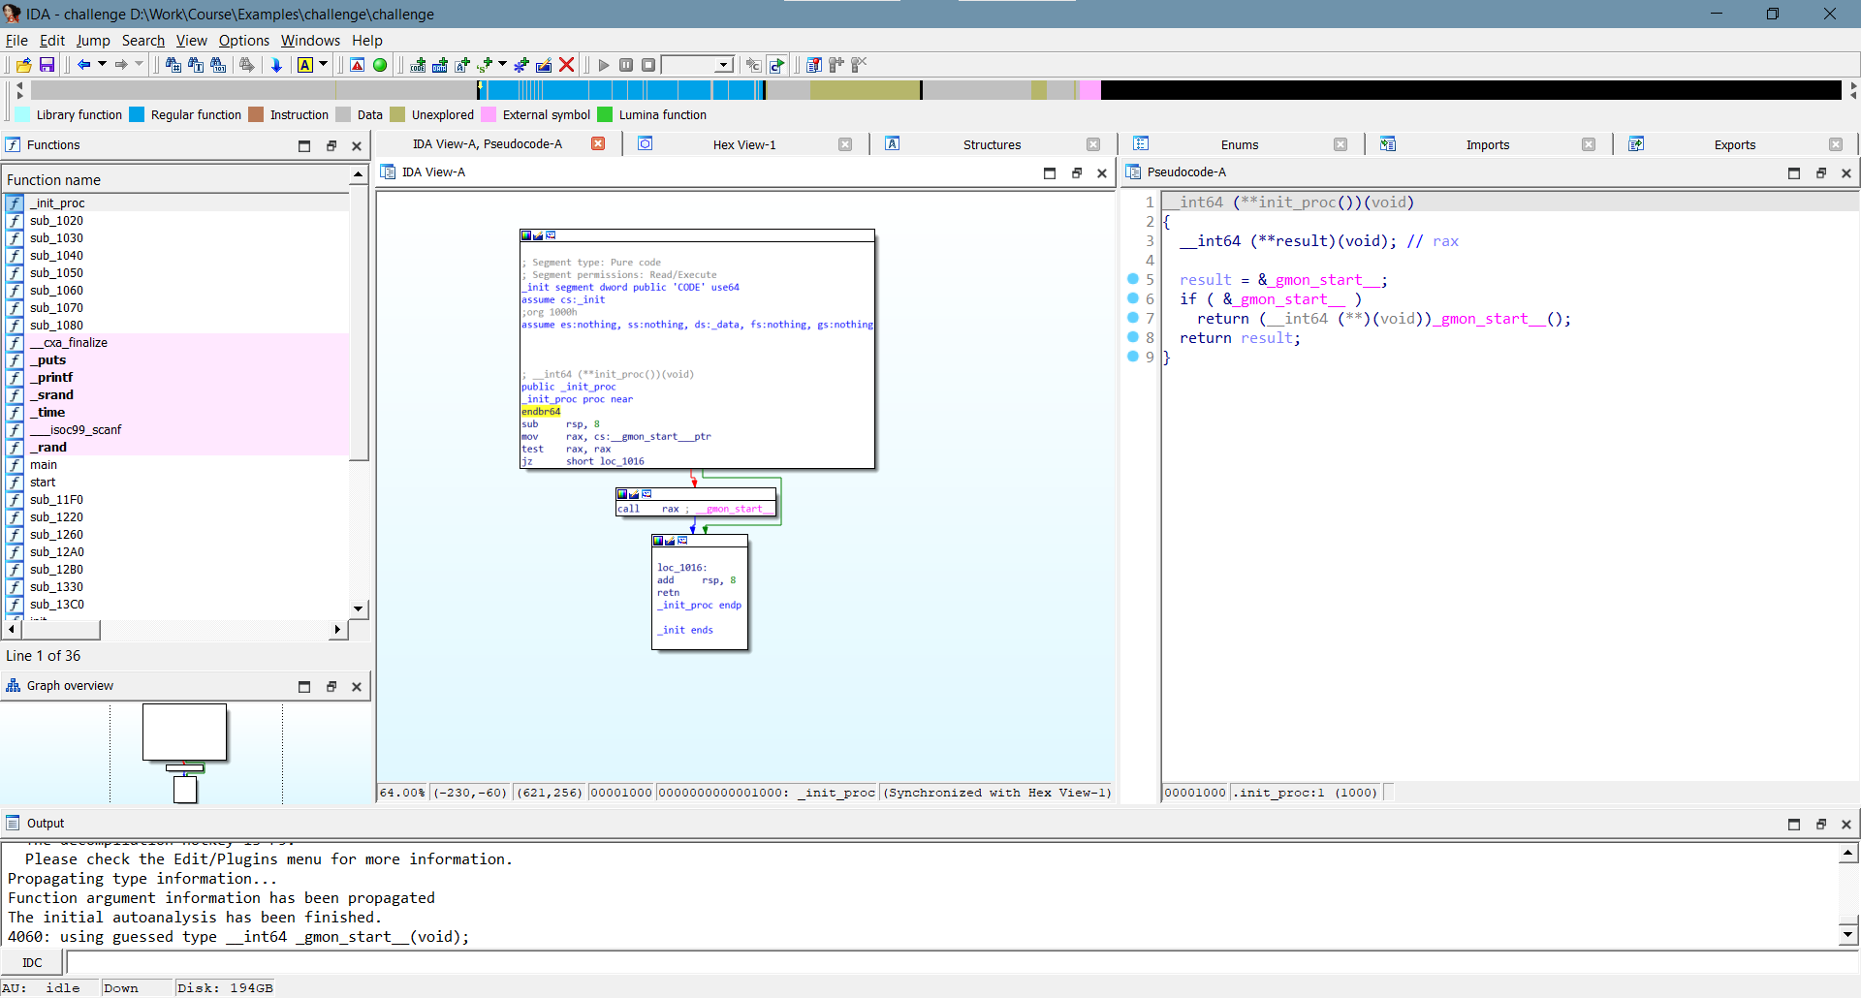

Slide 44
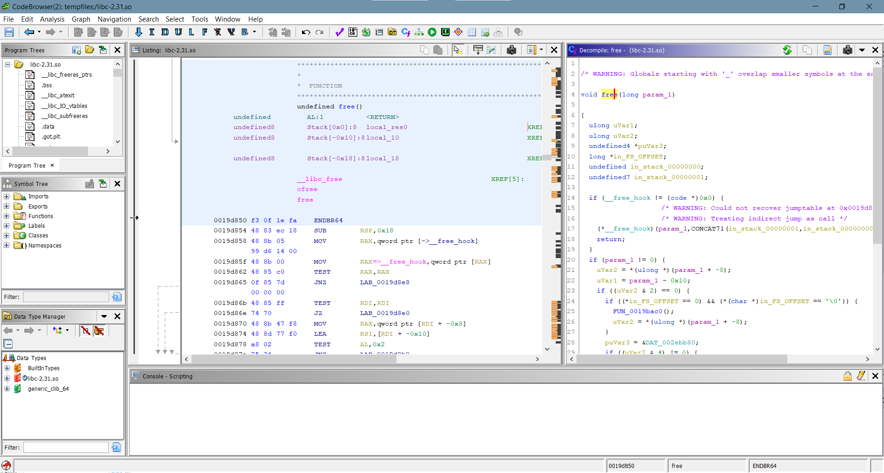

Slide 45
Tools of the trade
In this course we will be using IDA and Ghidra for reversing
We will not be using their decompilers for the first sets of exercises
Switching between the two can be annoying (especially the keyboard shortcuts – cheat sheets will be provided)
But each has its strengths so it’s best to familiarize ourselves with both

Slide 46
Tools of the trade
Debugging:
Many debuggers out there, but we will be using gdb (GNU debugger)
  GNU/Linux standard
  Works very well without sources
  Command-line interface (GUI/Text UI front-ends exist)
  Many plugins
    Of particular note is GEF (GDB Enhanced Features)
  We’ll show the basics but in general, the help command is your friend
  Command cheat sheets are very helpful (we’ll provide a decent one)

Slide 47
Example gdb session
(slightly edited for clarity)
$ gdb challenge
GNU gdb (Ubuntu 9.1-0ubuntu1) 9.1
Copyright (C) 2020 Free Software Foundation, Inc.
License GPLv3+: GNU GPL version 3 or later <http://gnu.org/licenses/gpl.html>
This is free software: you are free to change and redistribute it.
There is NO WARRANTY, to the extent permitted by law.
Type "show copying" and "show warranty" for details.
This GDB was configured as "x86_64-linux-gnu".
Type "show configuration" for configuration details.
For bug reporting instructions, please see:
<http://www.gnu.org/software/gdb/bugs/>.
Find the GDB manual and other documentation resources online at:
<http://www.gnu.org/software/gdb/documentation/>.
For help, type "help".
Type "apropos word" to search for commands related to "word"...
Reading symbols from challenge...
(No debugging symbols found in challenge)
(gdb) set disassembly-flavor intel
(gdb) break * 0x555555555168
Breakpoint 1 at 0x555555555168
(gdb) run
Starting program: /mnt/d/Work/Course/Examples/challenge/challenge
Breakpoint 1, 0x0000555555555168 in ?? ()
(gdb) x/10i $rip
=> 0x555555555168: call 0x5555555550e0 <__isoc99_scanf@plt>
0x55555555516d: cmp eax,0x1
0x555555555170: jne 0x5555555551aa
0x555555555172: mov rsi,QWORD PTR [rsp+0x8]
0x555555555177: mov rdi,rbp
0x55555555517a: call 0x555555555330
0x55555555517f: test rax,rax
0x555555555182: jne 0x55555555519a
0x555555555184: lea rdi,[rip+0xf13] # 0x55555555609e
0x55555555518b: call 0x5555555550a0 <puts@plt>
(gdb) stepi
0x00005555555550e0 in __isoc99_scanf@plt ()
(gdb) cont
Continuing.
[Inferior 1 (process 51) exited with code 0377]
(gdb)

Slide 48
Tools of the trade
Other tools:
Hex editors
  Used to display and edit binary files in hexadecimal representation
  For our purposes any editor will do
    you can consult Wikipedia:
    https://en.wikipedia.org/wiki/Comparison_of_hex_editors
Scripts and one-off tools
  We’ll encounter some later in the course

Slide 49
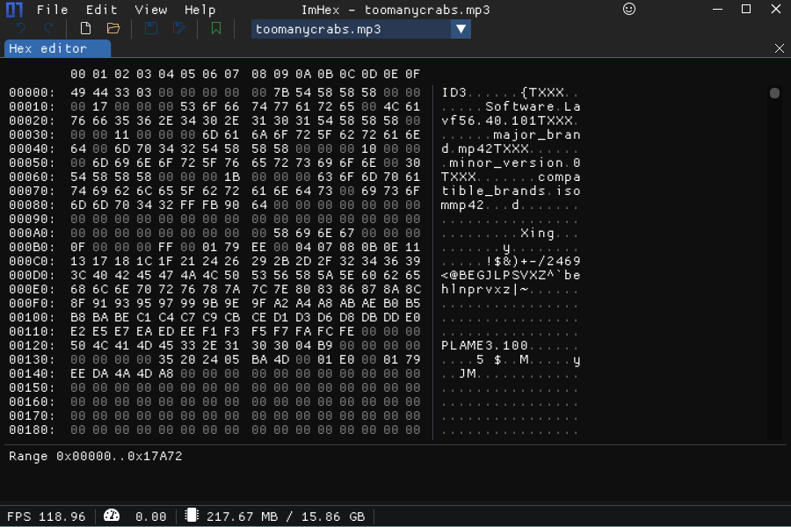

Slide 50
A note about documentation
“We don’t need documentation
We don’t need no source control”
                – Pink Floyd

Slide 51
A serious note about documentation
Documentation (both on-the-fly and as a final product) is as important in reverse engineering as it is in software development
While reverse engineering
  Give meaningful names to your functions and variables
    Even if you’re not entirely sure what they do
      IDA and Ghidra allow question marks as part of a symbol for a reason
  Use the comment features of IDA/Ghidra
  When you encounter complex code it’s worth writing down what it does step by step
    Words, diagrams, flowcharts, pseudocode and actual code are all valid
  Write a script any time you need to calculate something or for repetitive tasks
    You’ll probably need to use it again
    The script itself will serve as documentation
Whenever you reach a milestone in your research it’s worth writing a thorough report

Slide 52
About your exercises
Each exercise has a specific requirement in its instructions
  The end result is usually a piece of code or a binary file
Even if not explicitly required, every step of the solution is part of the solution
  All source files, Python scripts, etc.
  You should be able to reproduce the solution from scratch
We’re available in person and by email for any question

Slide 53
Let’s look at some tools

